Slide 1


E - COMMERCE
SALE DASHBOARD
BY KEERTHI REDDY & YAZHINI Y
01

Slide 2

INTRODUCTION
An E-Commerce Sales Dashboard is a data visualization tool that provides insights into an online store’s performance. It helps businesses track key sales metrics, customer behavior, product performance, and profitability in real time.
With the rise of digital commerce, businesses need efficient tools to analyze vast amounts of sales data. A well-designed dashboard offers:
✅ Real-time tracking of sales and profits
✅ Customer segmentation based on buying behavior
✅ Inventory management insights to prevent stockouts or overstocking
✅ Trend analysis to forecast demand and optimize marketing strategies
Using tools like Power BI, Tableau, Python, and SQL, businesses can create interactive dashboards that enable data-driven decision-making, improving overall efficiency and growth.

Slide 3


Data Collection
Methods
Data Sources: E-commerce transaction logs, customer databases, and product inventory records.
Data Points Collected: Order ID, Customer ID, Product Name, Category, Price, Quantity, Profit, Order Status, and Date.
Tools Used: Power BI for visualization, SQL for data extraction, and Excel for preprocessing.
Data Frequency: Daily updates to track real-time sales performance.
03

Slide 4

Tools for
Data Analysis
Data Collection & Storage
Data Processing & Cleaning
Data Visualization & Business Intelligence (BI)
Google Analytics – If you need real-time tracking of user behavior and conversions.
SQL (MySQL, PostgreSQL, or Microsoft SQL Server) – Ideal for structured e-commerce transaction data.
Microsoft Excel – Useful for quick data storage and manipulation.
Python (Pandas, NumPy) – Best for handling large datasets, filtering, and feature engineering.
Power Query (in Power BI & Excel) – If you're working within Power BI, this is great for data transformations
SQL Queries – To filter and aggregate data efficiently before visualization.
Power BI (Recommended – Best for real-time dashboards. Supports interactive charts and KPI tracking .Can integrate with SQL, Excel, and cloud databases.
Tableau – If you need more advanced drag-and-drop visual analytics.
Google Data Studio – Good for free online dashboards (but limited for deep analysis).
06

Slide 5
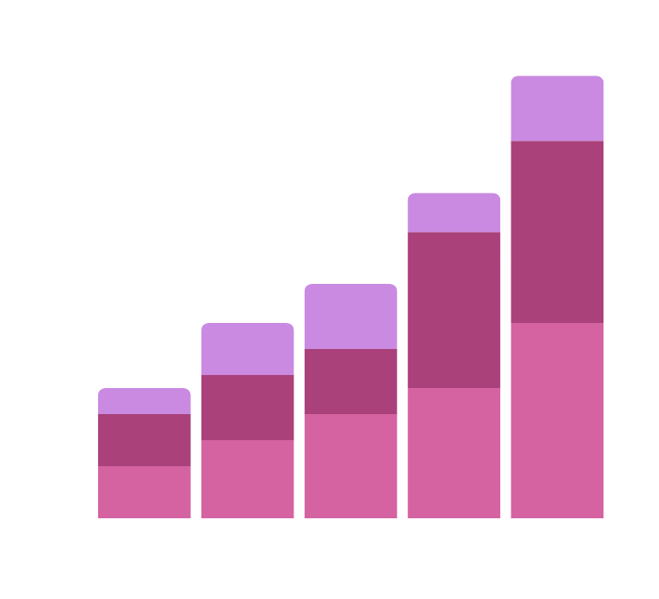
Marketing Channel
Performance
Sales Contribution by Source:
Google Ads
Instagram
Email Campaigns
Direct Traffic
Which marketing channels drive the most conversions?
Cost-effectiveness analysis of each channel
Visual Elements:
Bar chart: Sales contribution by marketing channel
Funnel chart: Conversion rates for each channel
05

Slide 6
Sales Trend
ANALYSIS
Daily/Monthly Sales Trends
Identify peak sales days/months
Seasonality in sales (e.g., holiday sales spikes)
Identify any declines and possible reasons
Visual Elements:
Line chart for sales over time
Heatmap for peak sales days
Bar chart comparing sales per month
08

Slide 7
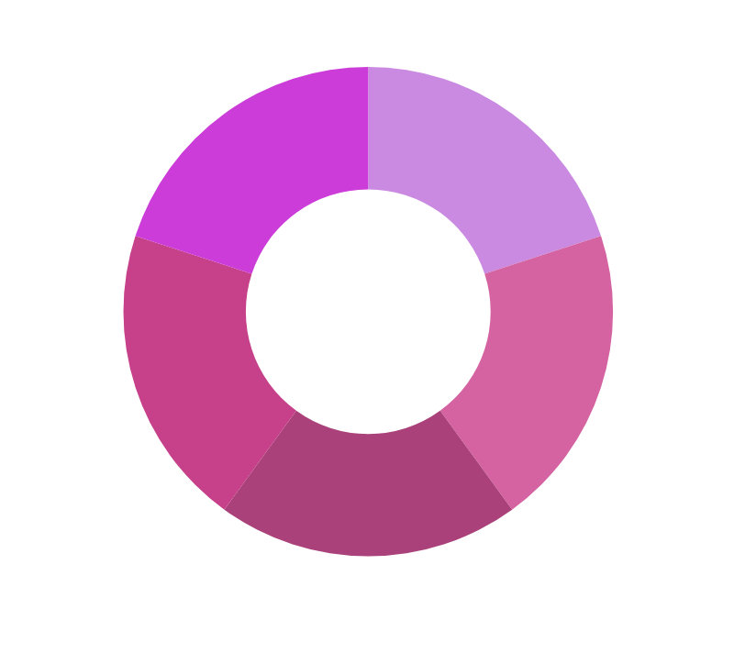
Product
Performance
Top 5 Best-selling Products
Least Selling Products & Possible Reasons
Category-wise Sales Contribution (Electronics, Fashion, etc.)
Identifying trending products vs. declining products
Visual Elements:
Bar graph: Top 5 and bottom 5 products
Pie chart: Sales contribution by category
09

Slide 8
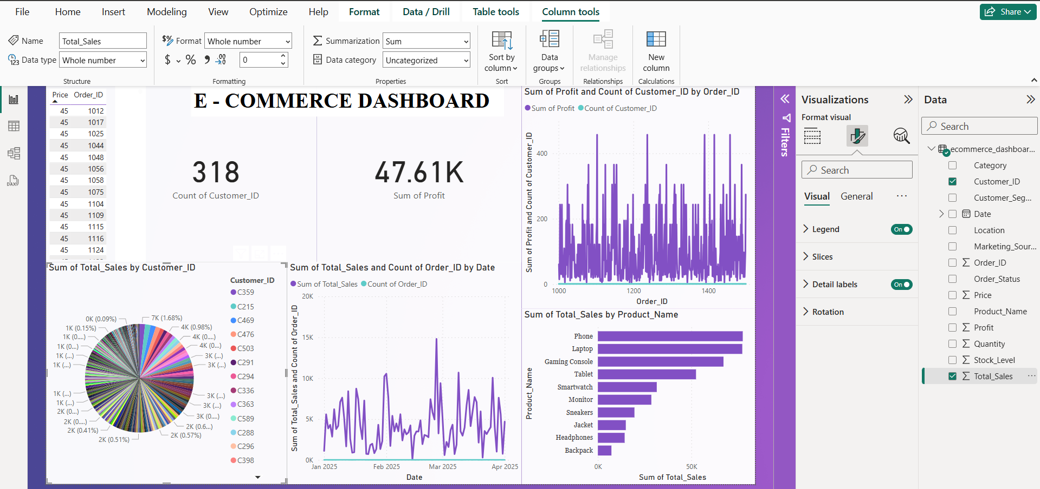
DASHBOARD USING
POWER BI
10

Slide 9
PYTHON CODE
TO VISUALIZE THE DATA
import pandas as pd
import matplotlib.pyplot as plt
import seaborn as sns
# Load dataset
df = pd.read_csv("ecommerce_dashboard_dataset.csv")
# Ensure 'Date' column is in datetime format
df['Date'] = pd.to_datetime(df['Date'], errors='coerce')
# Display basic info
print(df.info())
# ---- 1️⃣ Sales Overview ----
total_sales = df["Total_Sales"].sum()
total_profit = df["Profit"].sum()
unique_customers = df["Customer_ID"].nunique()
print(f"Total Sales: {total_sales}")
print(f"Total Profit: {total_profit}")
print(f"Unique Customers: {unique_customers}")
# ---- 2️⃣ Sales Trend Over Time ----
plt.figure(figsize=(10, 5))
sales_trend = df.groupby(df['Date'].dt.to_period("M"))["Total_Sales"].sum()
sales_trend.plot(marker='o', linestyle='-', color='b')
plt.title('Sales Trend Over Time')
plt.xlabel('Month')
plt.ylabel('Total Sales')
plt.grid(True)
plt.show()
# ---- 3️⃣ Top 10 Best-Selling Products ----
top_products = df.groupby("Product_Name")["Total_Sales"].sum().sort_values(ascending=False).head(10)
plt.figure(figsize=(12, 6))
sns.barplot(x=top_products.values, y=top_products.index, palette="viridis")
plt.title("Top 10 Best-Selling Products")
plt.xlabel("Total Sales")
plt.ylabel("Product Name")
plt.show()

Slide 10
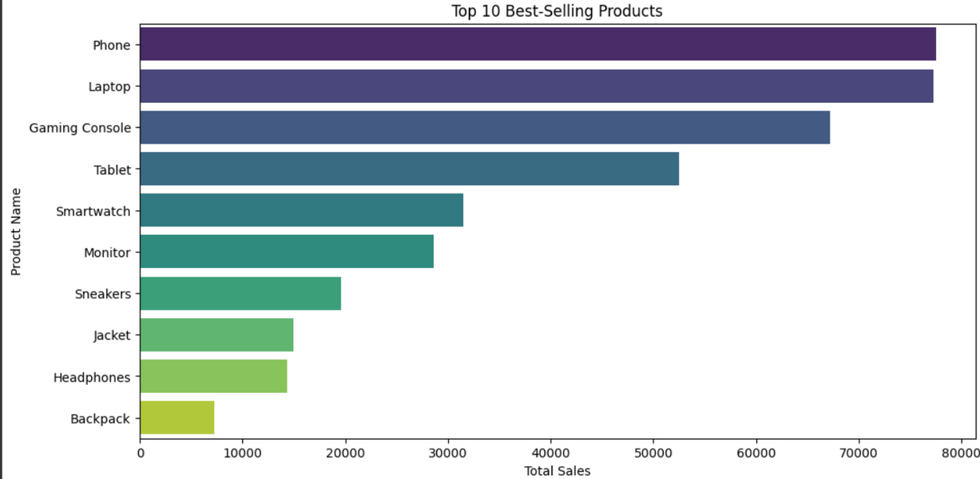
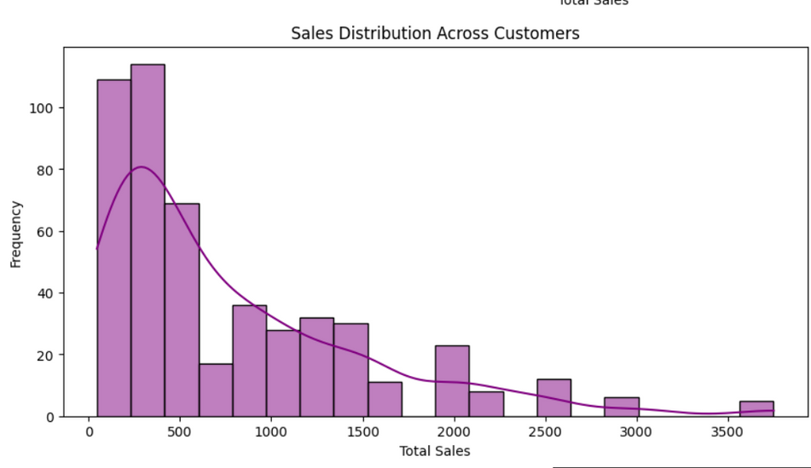
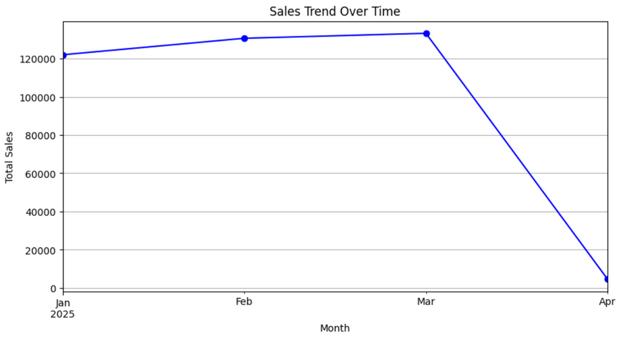
OUTPUT:

Slide 11

Challenges in
Data Analysis
DATA QUALITY ISSUES – INCOMPLETE, INCONSISTENT, OR INCORRECT DATA CAN LEAD TO INACCURATE INSIGHTS, REQUIRING EXTENSIVE CLEANING AND PREPROCESSING.
Handling Large Datasets – Analyzing massive datasets requires efficient storage, processing power, and optimization techniques to avoid performance bottlenecks.
Data Privacy & Security – Ensuring compliance with regulations (like GDPR) while protecting sensitive customer data is a major challenge in analytics.
11

Slide 12
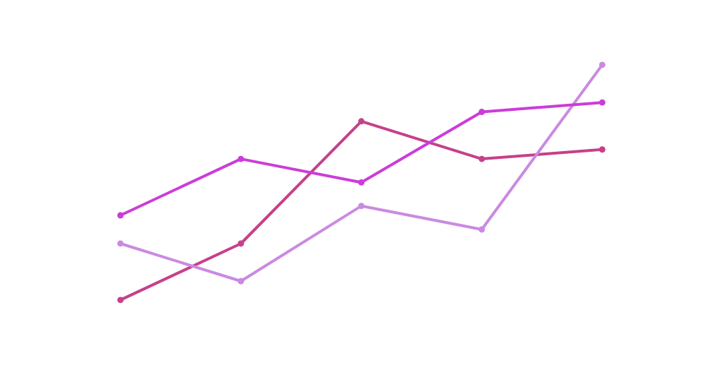
FUTURE SCOPE
Advanced Predictive Analytics
Implement AI & ML models to predict future sales trends.
Use time series forecasting (ARIMA, LSTM) to anticipate seasonal sales patterns.
Customer Segmentation & Personalization
Apply clustering techniques (K-Means, DBSCAN) to segment customers based on buying behavior.
Use recommendation engines to provide personalized product suggestions.
Real-time Sales Monitoring
Integrate IoT & real-time analytics for live tracking of stock levels, order processing, and delivery updates.
Enhanced Data Visualization & Automation
Utilize automated dashboards with AI-driven insights for dynamic decision-making.
Incorporate voice-based analytics for hands-free insights (e.g., using AI chatbots).
Omnichannel Sales & Marketing Integration
Track sales across multiple platforms (Amazon, Shopify, Social Media).
Use sentiment analysis on reviews and social media feedback for business improvement.
14

Slide 13
CONCLUSION
The E-commerce Sales Dashboard provides valuable insights into customer purchases, profit trends, and top-selling products.
It helps businesses optimize inventory, enhance marketing strategies, and improve customer satisfaction using data-driven decisions.
Future advancements in AI, machine learning, and automation will further refine decision-making, boosting revenue and customer engagement.

Slide 14
thank
you!
DATA ANALYSIS IS KEY TO BUSINESS GROWTH AND SUCCESS!
15

